Slide 1
Human Computer Interaction

Slide 2
Course Overview (1)
13.9.1 Code: ITU 08204
13.9.2 Name: Human Computer Interface Design
13.9.3 Number of Credits 12
13.9.4 Sub enabling outcomes:
2.6.1 Describe fundamental principles for Human Computer
Interaction
2.6.2 Describe Paradigms of Human Computer Interaction
2.6.3 Describe constituent of HCI design process
2.6.4 Discuss design approaches that are suitable to
different classes of user and application
2.6.5 Discuss different kinds of prototyping to be used for
different purposes at different stages

Slide 3
Course Overview (2)
1. History and Future of HCI
(i) History of HCI
(ii) Future HCI technologies (Research & Prediction)
2. Goals of HCI, Affordance, Usability and Usability Principles
3. Human Factors in Interaction Design
4. Prototyping Purpose, Process and Techniques
5. User-Centered Design Basics
6. Usability Evaluation Basics (Usability Testing)
7. Process of Interaction Design

Slide 4
Goals of HCI
Allow users to carry out tasks
Safely
Effectively
Efficiently
Enjoyably

Slide 5
What happens when a human and a computer get together to perform a task
HCI
– task - write document, calculate budget, solve equation, learn about Antarctica, drive home,...

Slide 6


HCI Deals With The Interaction Of A
Person And A Computer
Technological perspective
Human perspective

Slide 7


Human Perspective
How people process information
Memory, perception, motor skills, attention etc.
Language, communication and interaction Ergonomics

Slide 8
Human Computer Interaction
A discipline concerned with the
design, implementation and evaluation
…of interactive computing systems for human use
design
evaluation
implementation

Slide 9
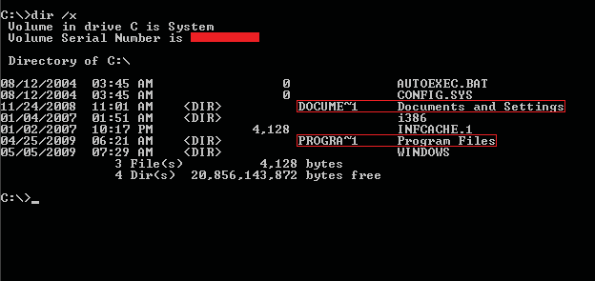
EXAMPLES OF USER INTERFACES

Slide 10
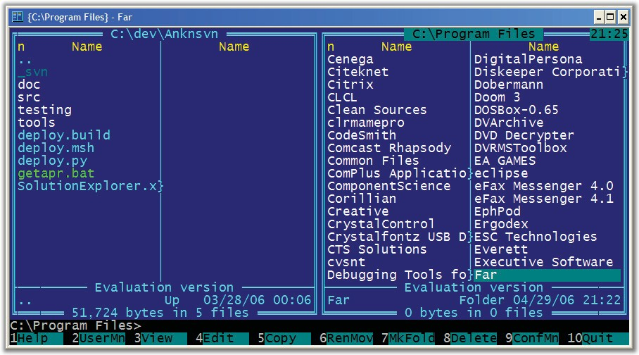
EXAMPLES OF USER INTERFACES

Slide 11
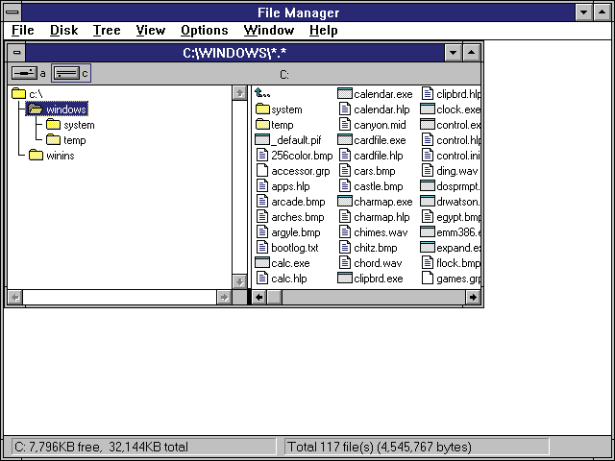
EXAMPLES OF USER INTERFACES

Slide 12
History of Human Computer Interaction

Slide 13

Agenda
Where did HCI innovations and philosophy come from?
Who were the major personalities?
What were the important systems?
How did ideas move from the laboratory to the market

Slide 14
Input/output devices
History of HCI
Input Output
Early days
connecting wires
paper tape & punch cards keyboard
lights on display paper
teletype
Today
keyboard
+ cursor keys
+ mouse
+microphone
scrolling glass teletype character terminal
bit-mapped screen audio
Soon?
data gloves + suits computer jewelry natural language cameras
head-mounted displays ubiquitous computing autonomous agents multimedia
The lesson
keyboards & terminals are just artifacts of today’s technologies
new input/output devices will change the way we interact with computers

Slide 15
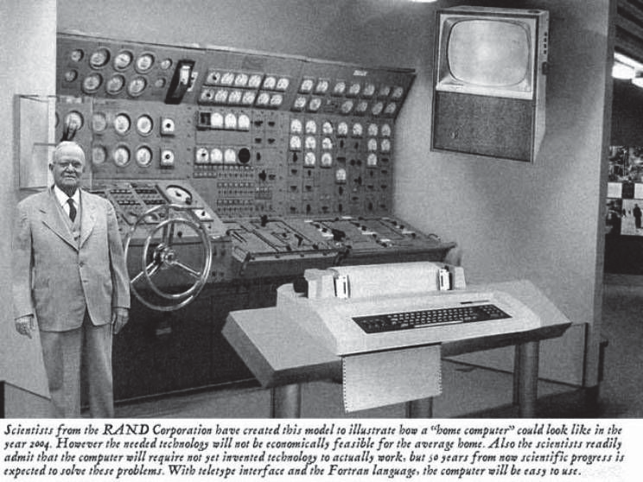
RAND’s vision of the future
History of HCI

Slide 16
Future Prediction
A previous picture is from an issue of 1954 Popular Mechanics magazine forecasting the possibility of ‘home computers’ in 50 years. It appears that the ‘mouse’ replaced the steering wheel …
“Scientists from RAND Corporation have created this model to illustrate how a “home computer” could look in the year 2004. However the needed technology will not be economically feasible for the average home. Also the scientists readily admit that the computer will require not yet invented technology to actually work, but 50 years from now scientific progress is expected to solve these problems. With teletype interface and the Fortran language, the computer will be easy to use.”

Slide 17
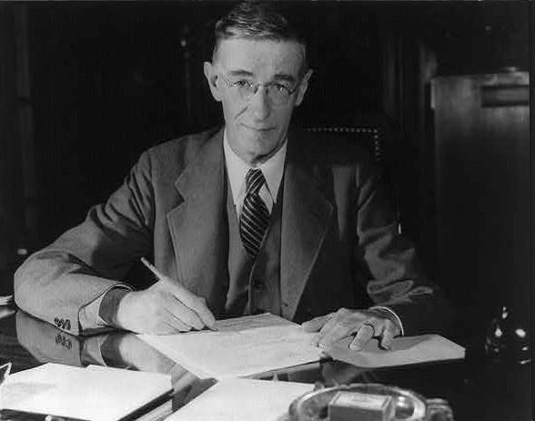
“As We May Think”
Vannevar Bush (1945)
4

Slide 18
History of HCI

Slide 19
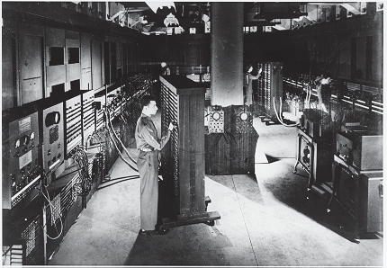
Eniac (1943)
History of HCI
– A general view of the ENIAC, the world's first all electronic numerical integrator and computer.
From IBM Archives.

Slide 20
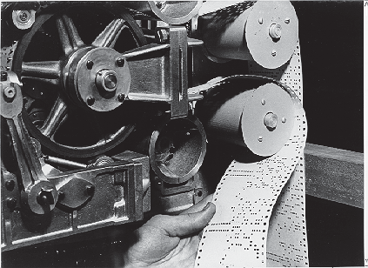
Mark I (1944)
History of HCI
– The Mark I paper tape readers.
From Harvard University Cruft Photo Laboratory.

Slide 21
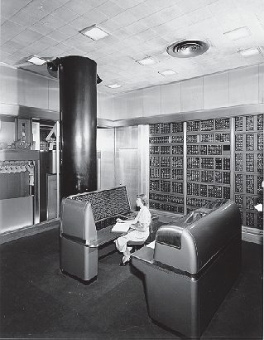
IBM SSEC (1948)
History of HCI
From IBM Archives.

Slide 22
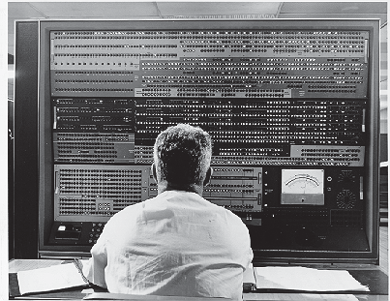
Stretch (1961)
History of HCI
A close-up of the Stretch technical control panel.
From IBM Archives.

Slide 23
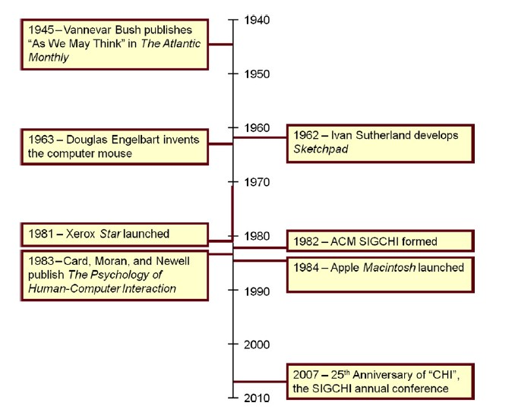

Slide 24




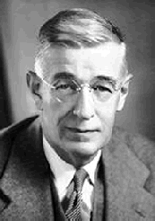
Vannevar Bush (1890-1974)
“As We May Think” - 1945 Atlantic Monthly
“…publication has been extended far beyond our present ability to make real use of the record.”
6

Slide 25


Intellectual foundations
History of HCI
Vannevar Bush (1945)
“As we may think” article in Atlantic Monthly
Identified the information storage and retrieval problem: new knowledge does not reach the people who could benefit from it
“publication has been extended far beyond our present ability to make real use of the record”

Slide 26

Key issues
The summation of human experience is being expanded at a prodigious rate, and the means we use for threading through the consequent maze to the momentarily important item is the same as was used in the days of square-rigged ships (p. 37).
Bush’s consequent maze is today’s information overload or lost in hyperspace .
Bush’s momentarily important item sounds a bit like a blog posting or a tweet.
Bush proposed navigating the knowledge maze with a device he called memex… associative indexing.

Slide 27
Key issues
The summation of human experience is being expanded at a prodigious rate, and the means we use for threading through the consequent maze to the momentarily important item is the same as was used in the days of square-rigged ships (p. 37).
– memex with hypertext and the World Wide Web, Bush’s inspiration for this idea came from the contemporary telephone exchange

Slide 28

Vannevar Bush (1945)
Postulated Memex device
Can store all records/articles/communications
Large memory
Items retrieved by indexing, keywords, cross references
Can make a trail of links through material etc.
Envisioned as microfilm, not computer
10

Slide 29
History of HCI

Slide 30
Eniac (1943)
History of HCI
– A general view of the ENIAC, the world's first all electronic numerical integrator and computer.
From IBM Archives.

Slide 31
Mark I (1944)
History of HCI
– The Mark I paper tape readers.
From Harvard University Cruft Photo Laboratory.

Slide 32
IBM SSEC (1948)
History of HCI
From IBM Archives.

Slide 33
Stretch (1961)
History of HCI
A close-up of the Stretch technical control panel.
From IBM Archives.

Slide 34
Bush’s Memex
History of HCI
Memex is the name of the hypothetical electromechanical device that Vannevar Bush described in his 1945 article "As We May Think". Bush envisioned the memex as a device in which individuals would compress and store all of their books, records, and communications, "mechanized so that it may be consulted with exceeding speed and flexibility". The individual was supposed to use the memex as automatic personal filing system, making the memex "an enlarged intimate supplement to his memory“
Source: Wikipedia
https://en.wikipedia.org/wiki/Memex

Slide 35
Bush’s Memex
History of HCI
Conceiving Hypertext and the World Wide Web
a device where individuals stores all personal books, records, communications etc
items retrieved rapidly through indexing, keywords, cross references,...
can annotate text with margin notes, comments...
can construct and save a trail (chain of links) through the material
acts as an external memory!
Bush’s Memex based on microfilm records!
mmm m mmm m mmm mm
– but not implemented
mmm m mmm m mmm mm mmm m mmm
mmmm mmmm mmm mm mmmm mmm
mmmm mmmm mmm mm mmmm mmm
mmm m mmm

Slide 36
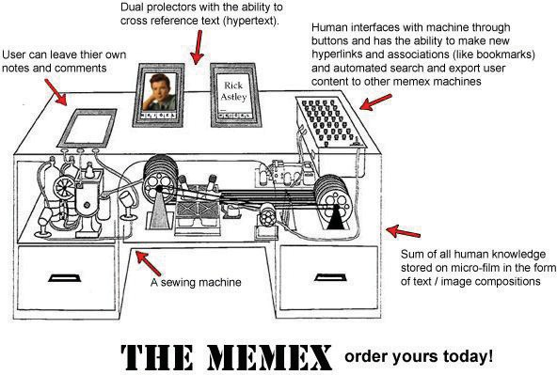

Slide 37
The concept of the memex influenced the development of
early hypertextsystems (World Wide Web) and
personal knowledge base software.

Slide 38
SketchPad

Slide 40
computer program written by Ivan Sutherland in 1963 in the course of his PhD thesis.
considered to be the ancestor of modern computer- aided design (CAD) programs as well as a major breakthrough in the development of computer graphics in general.
the graphical user interface (GUI) was derived from the Sketchpad as well as modern object oriented programming.

Slide 41



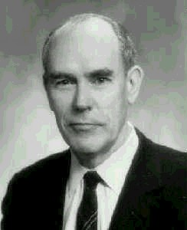
Ivan Sutherland (1938-)
SketchPad: 1963 PhD thesis at MIT
Hierarchy - pictures & subpictures
Master picture with instances
Constraints
Icons
Copying
Light pen as input device
Recursive operations
© M. Rauterberg, TU/e
17

Slide 42
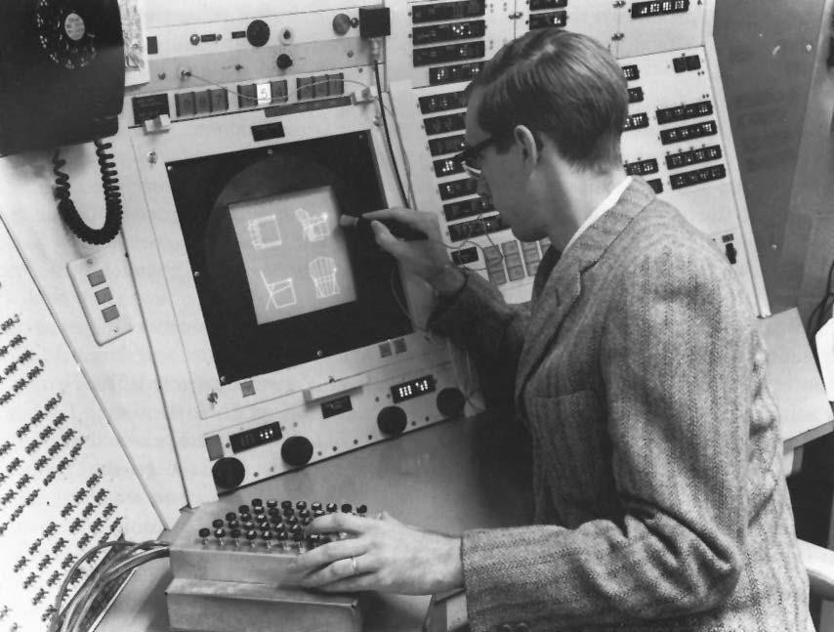
Sketchpad
Ivan Sutherland (1962)
18

Slide 43

Sketchpad
Commands were not typed
users did not write letters to the computer
They were
drawn
grabbed and moved
extended
deleted
directly manipulated using a lightpen
19

Slide 44


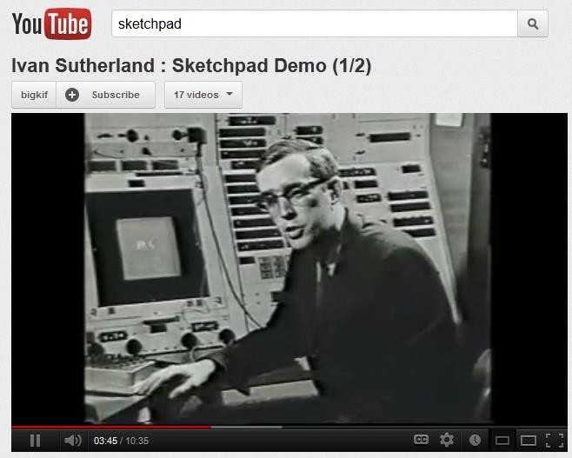
Viewable on…
Click here
20

Slide 45













Sketchpad: “Direct Manipulation”
Direct manipulation features:
Visibility of objects
Incremental action and rapid feedback
Reversibility
Exploration
Syntactic correctness of all actions
Replacing language with action
Term coined by Ben Shneiderman¹
¹ Shneiderman, B., Direct manipulation: A step beyond programming languages, in IEEE Computer, 1983, August, 57-69.

Slide 46
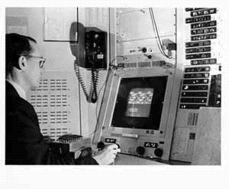
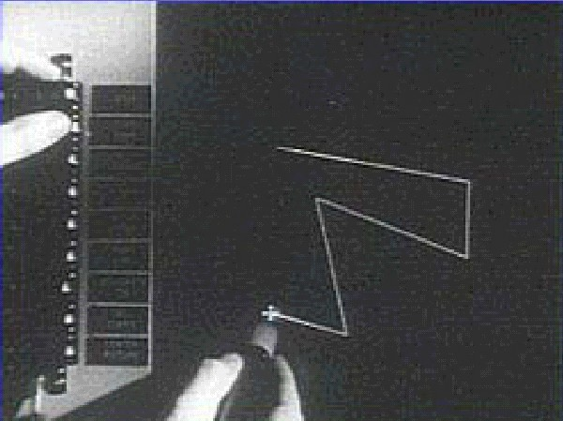
Sketchpad (1963)
Input device: Light pen used on cathode ray tube.
Graphical objects could be drawn and modified through constraints.
Object oriented modell.
Ivan Sutherland using the console of the TX-2 at MIT
Copy and paste.
© MIT Lincoln Lab
22

Slide 47
Investion of Computer Mouse

Slide 48
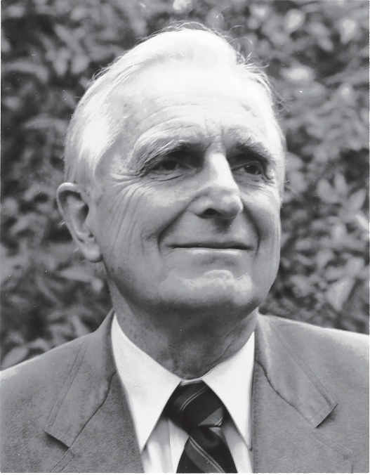
Douglas Engelbart
History of HCI
The Problem (early ‘50s)
“...The world is getting more complex, and problems are getting more urgent. These must be dealt with collectively. However, human abilities to deal collectively with complex
/ urgent problems are not increasing as fast as these problems.
If you could do something to improve human capability to deal with these problems, then you'd really contribute something basic.”
...Doug Engelbart

Slide 50
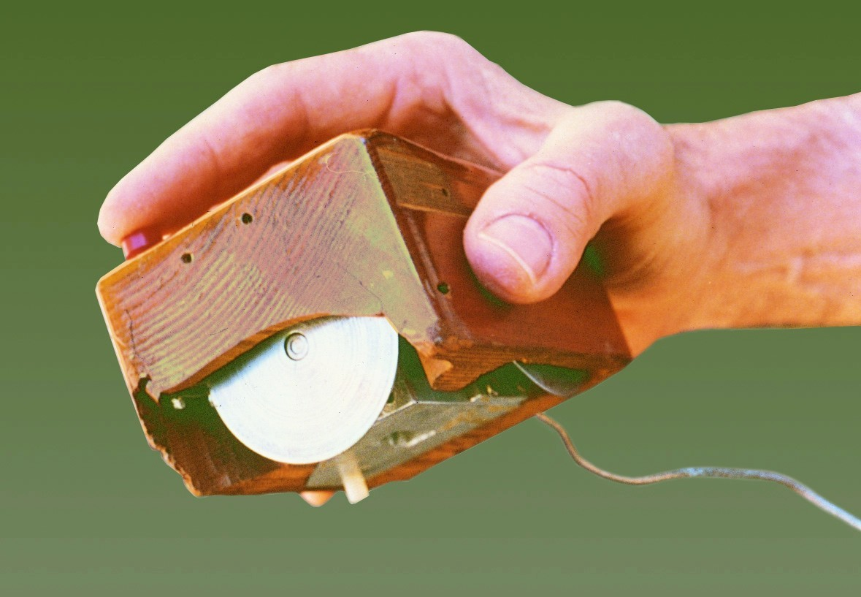
first mouse by Douglas C. Engelbard at Stanford (1964)

Slide 51


The First Mouse (1964)
History of HCI

Slide 52




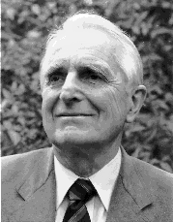
Douglas C. Engelbart (1925 - )
Engelbart invented the mouse at Stanford Research Labs in 1964.
Landmark system/demo:
hierarchical hypertext, multimedia, mouse,
high-resolution display, windows, shared files, electronic messaging, CSCW, teleconferencing, …
Augment/NLS system [NLS: oN Line System]
© M. Rauterberg, TU/e
27

Slide 53
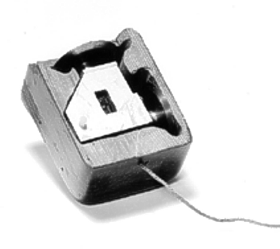
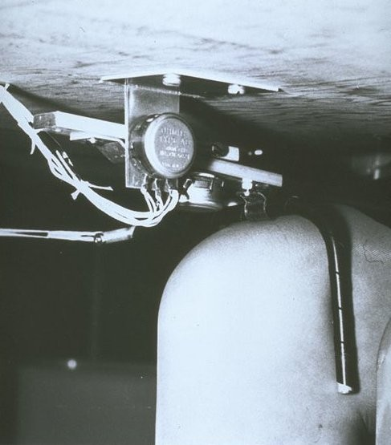
The First Mouse (1964)
Knee control
Douglas Engelbart
Years before personal computers and desktop information processing became commonplace or even practicable, Douglas Engelbart had invented a number of interactive, user-friendly information access systems that we take for granted today: the computer mouse, windows, shared-screen teleconferencing, hypermedia, groupware, and more.
© M. Rauterberg, TU/e
28

Slide 54
Xerox Star - ‘81

Slide 56



Xerox Star - ‘81
First commercial PC designed for “business professionals”
Desktop metaphor, pointing, WYSIWYG
become standard in personal computers, including
a bitmapped display,
a window-based graphical user interface,
icons, folders,mouse (two-button),
Ethernet networking,
file servers,
print servers and
e-mail.
32

Slide 57
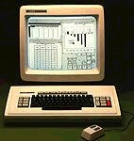
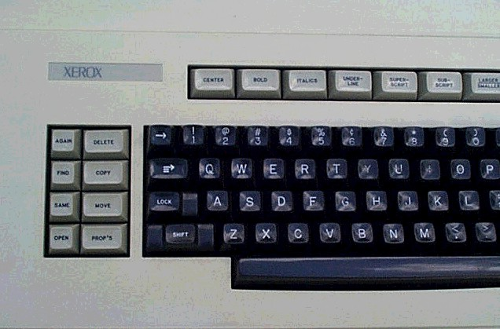
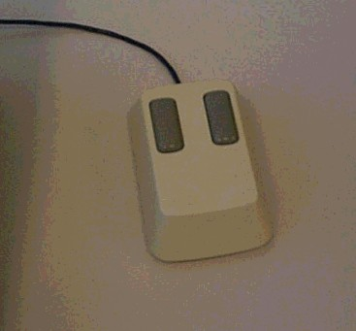
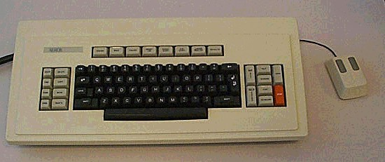
Xerox Star (1981)
© M. Rauterberg, TU/e
33

Slide 58
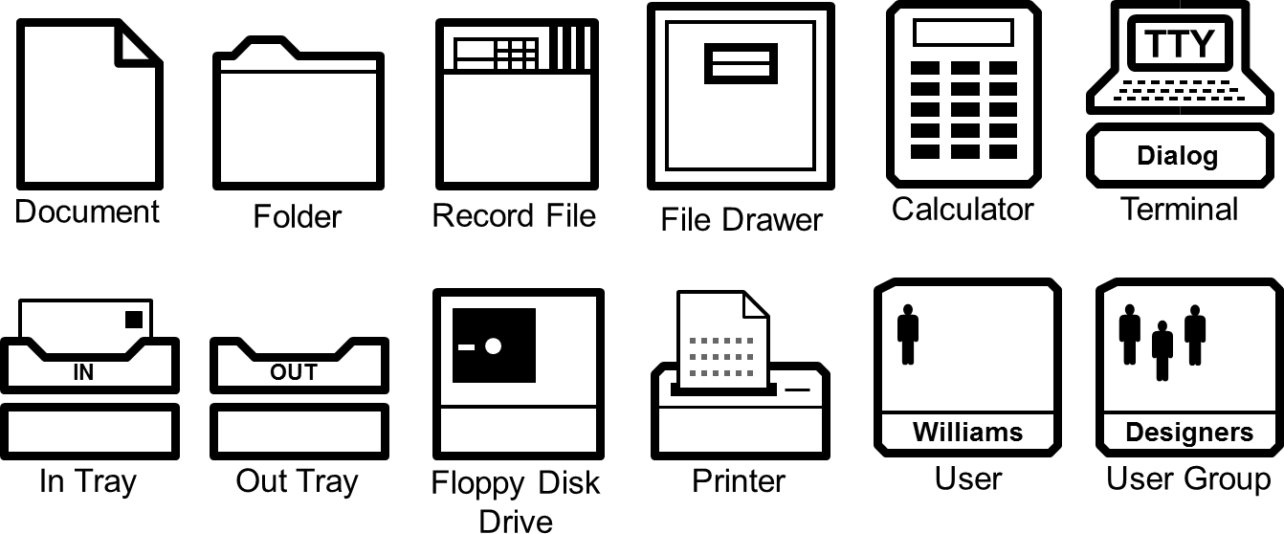
Star GUI Icons
34

Slide 59
Douglas Engelbart
History of HCI
The Problem (early ‘50s)
“...The world is getting more complex, and problems are getting more urgent. These must be dealt with collectively. However, human abilities to deal collectively with complex
/ urgent problems are not increasing as fast as these problems.
If you could do something to improve human capability to deal with these problems, then you'd really contribute something basic.”
...Doug Engelbart

Slide 60
Douglas Engelbart
History of HCI
A Conceptual Framework for Augmenting Human Intellect
(SRI Report, 1962)
"By augmenting man's intellect we mean increasing the capability of a man to approach a complex problem situation, gain comprehension to suit his particular needs, and to derive solutions to problems.
One objective is to develop new techniques, procedures, and systems that will better adapt people's basic information-handling capabilities to the needs, problems, and progress of society."
...Doug Engelbart

Slide 61
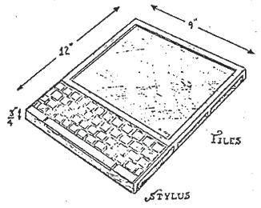
The Personal Computer
History of HCI
Alan Kay (1969)
– Dynabook vision (and cardboard prototype) of a notebook computer:
“Imagine having your own self-contained knowledge manipulator in a portable package the size and shape of an ordinary notebook. Suppose it had enough power to out-race your senses of sight and hearing, enough capacity to store for later retrieval thousands of page-equivalents of reference materials, poems, letters, recipes, records, drawings, animations, musical scores...”

Slide 62
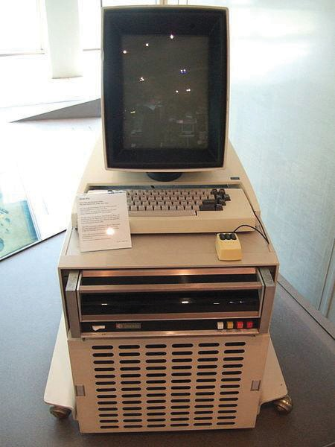
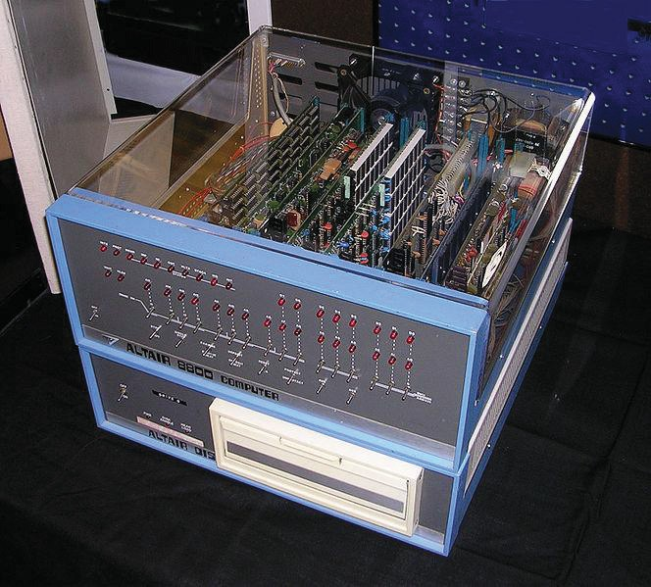
The Personal Computer
History of HCI
Xerox PARC, mid-’70s
Alto computer, a personal workstation
local processor, bit-mapped display, mouse
modern graphical interfaces
text and drawing editing, electronic mail
windows, menus, scroll bars, mouse selection, etc
local area networks (Ethernet) for personal workstations
could make use of shared resources
ALTAIR 8800 (1975)
Popular electronics article that showed people how to build a computer for under $400

Slide 63
Commercial machines:Xerox Star-1981
History of HCI
First commercial personal computer designed for “business professionals”
First comprehensive GUI used many ideas developed at Xerox PARC
familiar user’s conceptual model (simulated desktop)
promoted recognizing/pointing rather than remembering/typing
property sheets to specify appearance/behaviour of objects
what you see is what you get (WYSIWYG)
small set of generic commands that could be used throughout the system
high degree of consistency and simplicity
modeless interaction
limited amount of user tailorability

Slide 64
Xerox Star (continued)
History of HCI
First system based upon usability engineering
inspired design
extensive paper prototyping and usage analysis
usability testing with potential users
iterative refinement of interface
Commercial failure
– cost ($15,000);
IBM had just announced a less expensive machine
limited functionality
e.g., no spreadsheet
closed architecture,
3rd party vendors could not add applications
perceived as slow
but really fast!

Slide 65
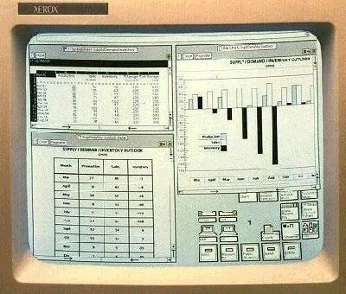
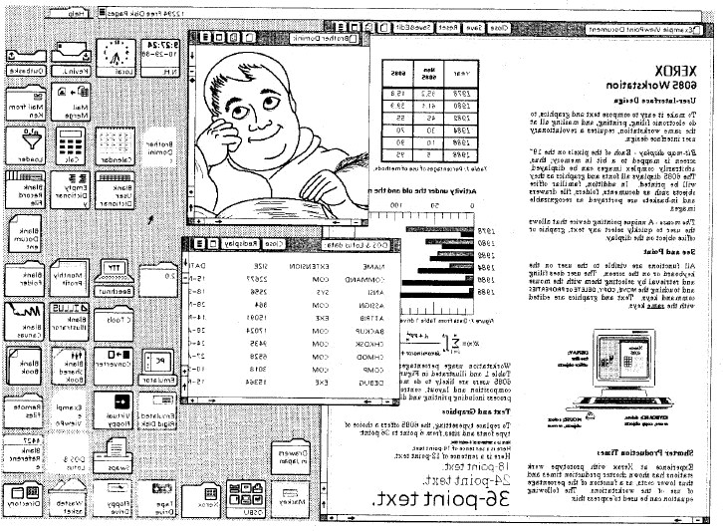
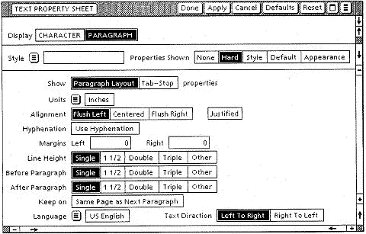
Xerox Star (GUI)
© M. Rauterberg, TU/e
35

Slide 66
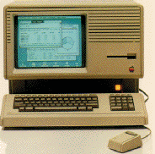
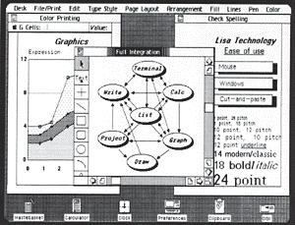
Commercial Machines: Apple Lisa (1983)
History of HCI
based upon many ideas in the Star
predecessor of Macintosh,
somewhat cheaper ($10,000)
commercial failure as well
http://fp3.antelecom.net/gcifu/applemuseum/lisa2.html

Slide 67
Commercial Machines: Apple Macintosh (1984)
History of HCI
“Old ideas” but well done!
succeeded because:
aggressive pricing ($2500)
did not need to trailblaze
learnt from mistakes of Lisa and corrected them; ideas now “mature”
market now ready for them
developer’s toolkit encouraged 3rd party non-Apple software
interface guidelines encouraged consistency between applications
domination in desktop publishing because of affordable laser printer
and excellent graphics

Slide 68

Xerox Star (history)
Commercial flop
$15k cost
closed architecture
lacking key functionality (spreadsheet)
© M. Rauterberg, TU/e
36

Slide 69
ACM Conference

Slide 71

ACM Conference
The ACM Special Interest Group on Computer- Human Interaction is the world’s largest association of professionals who work in the research and practice of computer-human interaction.
This interdisciplinary group is composed of computer scientists, software engineers, psychologists, interaction designers, graphic designers, sociologists, and anthropologists, just to name some of the domains whose special expertise come to bear in this area.

Slide 72
ACM Conference
They are brought together by a shared understanding that designing useful and usable technology is an interdisciplinary process, and believe that when done properly it has the power to transform persons’ lives.

Slide 73



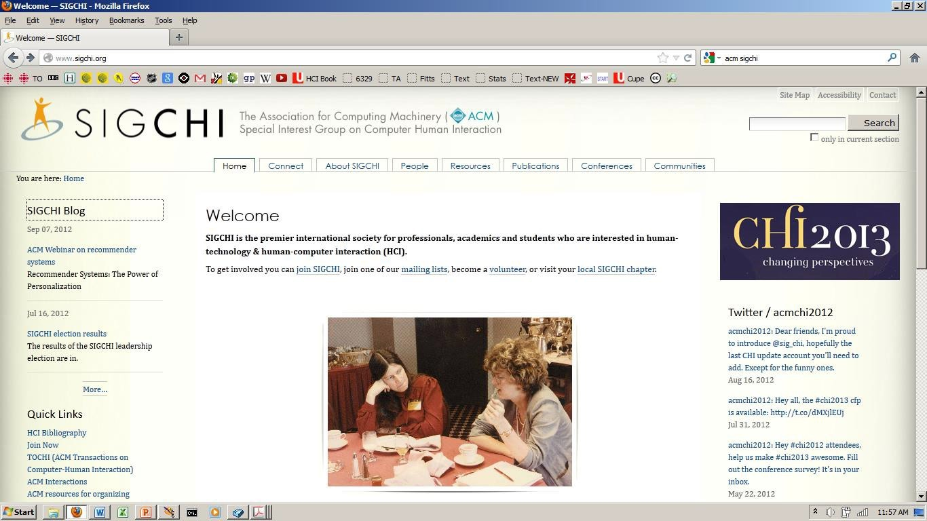
SIGCHI Web Site
Click here
41

Slide 74
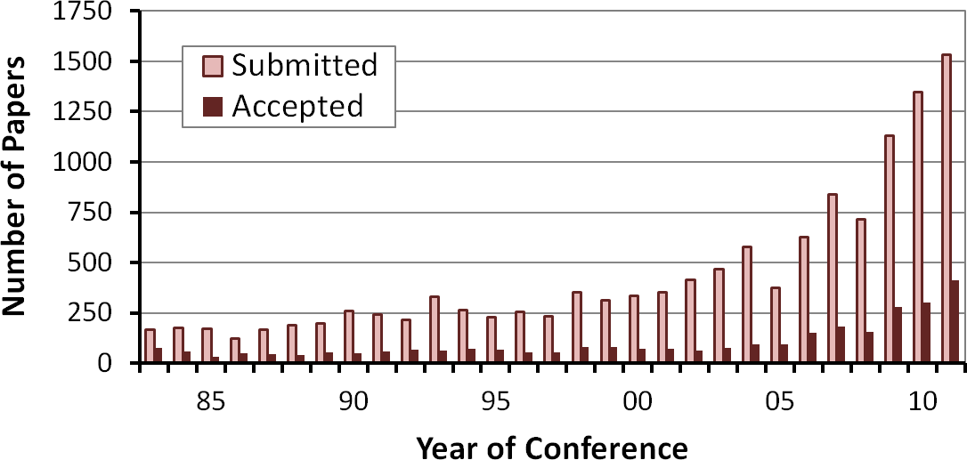
SIGCHI Conference Publications
42

Slide 75
The Psychology of Human-Computer Interaction

Slide 77
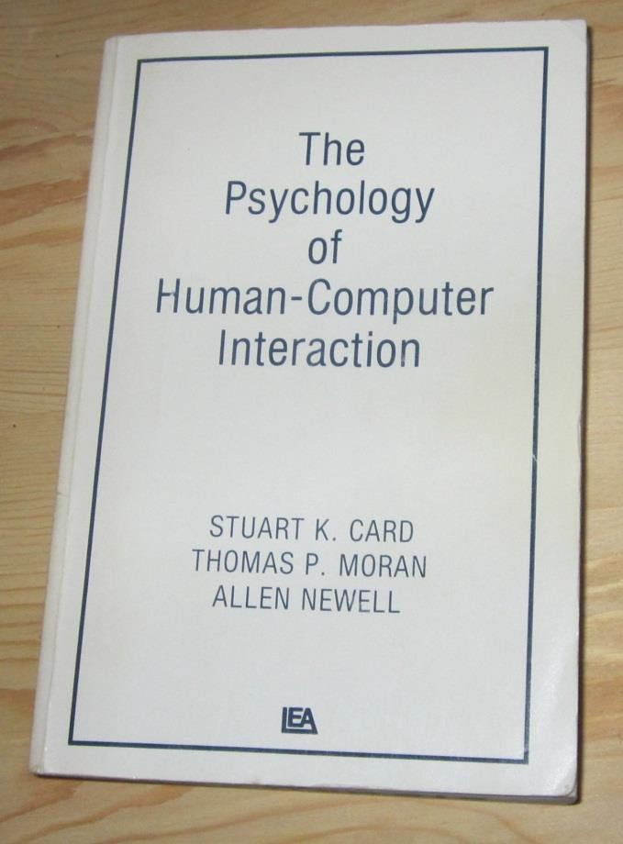
The Psychology of Human-Computer Interaction
Card, Moran, and Newell (1983)
45

Slide 78
The Psychology of Human- Computer Interaction
First 100 pages are on human psychology
sensory
cognitive
motor
must understand human first before building an interface for humans
Exploit synergy between psychology and computer science
completely novel idea/concept back then
man-machine psychology, human factors, HCI
46

Slide 79
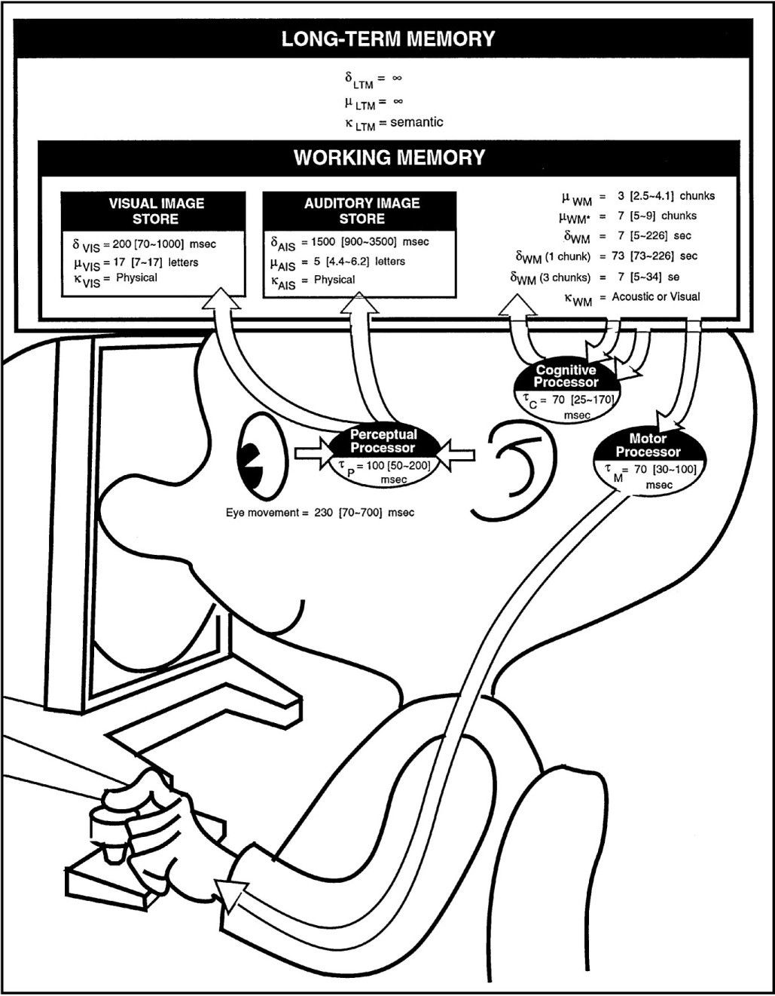
The Model Human Processor
48

Slide 80
Launch of the Apple Macintosh (1984)

Slide 82
Steve Jobs launches Apple Mac in 1984: You can watch video through the link below
https://www.youtube.com/watch?v=p2muzsBql7E

Slide 83
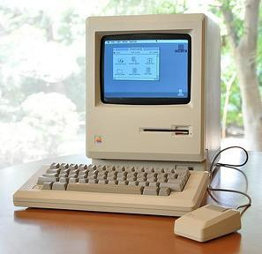
Apple Macintosh (1984)
52

Slide 84
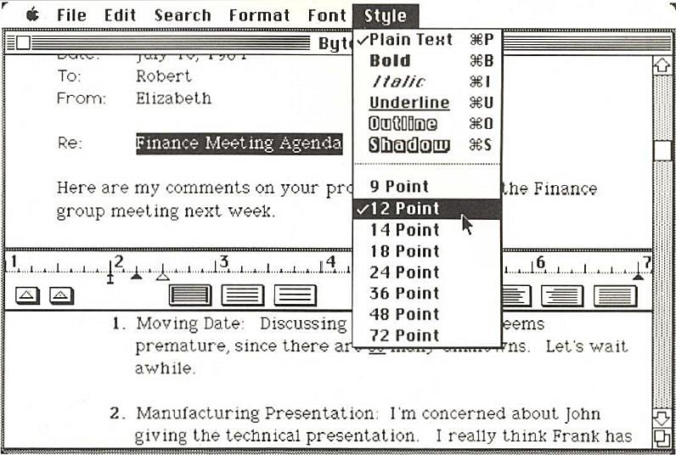
MacWrite Software
53

Slide 85
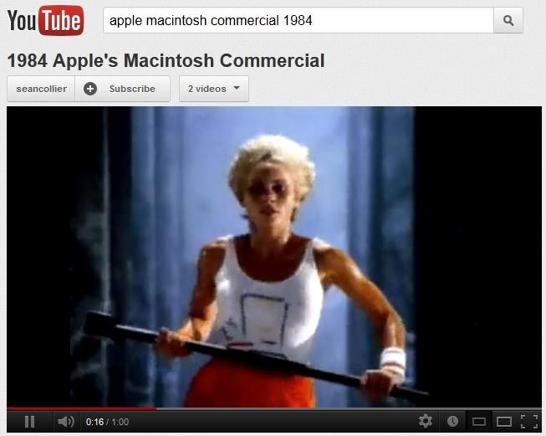
Apple Macintosh Superbowl Commercial (1984)
Click here
54

Slide 86
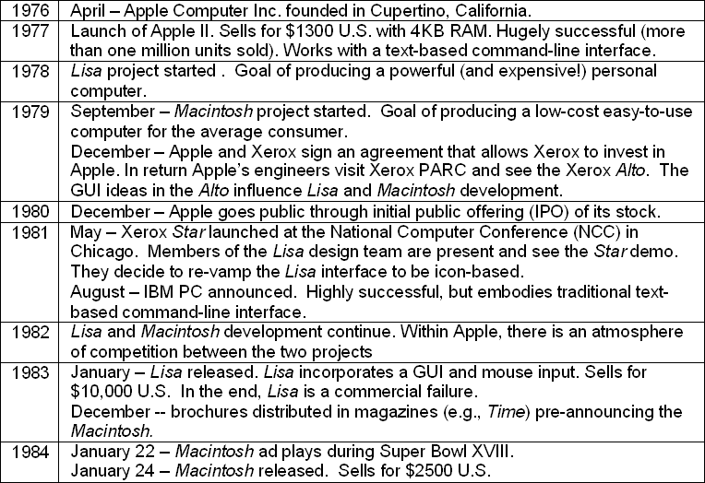
Apple Macintosh Timeline
55

Slide 87
Growth of HCI and graphical user interfaces (GUIs)

Slide 88
With the formation of ACM SIGCHI in 1983 and the release and success of the Apple Macintosh in 1984, human-computer interaction was off and running.
GUIs entered the mainstream and, consequently, a much broader community of users and researchers were exposed to this new genre of interaction.

Slide 89
Microsoft was a latecomer in GUIs.
Early versions of Microsoft Windows appeared in 1985, but it was not until the release of Windows 3.0 (1990) and in particular Windows 3.1 (1992) that Microsoft Windows was considered a serious alternative to the Macintosh operating system.
– Windows 95 (1995),
– Windows 98 (1998),
Windows XP (2001),
and Windows 7 (2009).

Slide 90
History (and future) of HCI
-Large displays
-Small displays
-Peripheral displays -Alternative I/O
-Ubiquitous computing -Virtual environments
-Implants
-Speech recognition
-Multimedia
-Video conferencing
-Artificial intelligence
-Software agents (AI: Alexa and Siri)
-Recommender systems (Machine Learning)
...

Slide 91
You know now:
History of HCI
HCI importance result of:
cheaper/available computers/workstations meant people more important than machines
excellent interface ideas modeled after human needs instead of system needs (user centered design)
evolution of ideas into products through several generations
pioneer systems developed innovative designs, but often commercially unviable
settler systems incorporated (many years later) well-researched designs
people no longer willing to accept products with poor interfaces

